Slide 1
RevPay
Secure Digital Payment System

Slide 2
Introduction
RevPay is a console-based financial application designed for secure digital payments and comprehensive business finance management. Built using Java and JDBC, it offers a modular system with role-based access, ensuring easy management of payments, invoicing, and loans while maintaining strong security and auditability standards.

Slide 3

01
Project Overview

Slide 4
Problem Statement and Objectives
Digital payments require enhanced security, auditability, and strict role-based access control. Businesses also need reliable invoicing and loan management features. Existing payment apps are often overly complex, so RevPay was developed as a modular console application that simplifies these tasks while providing secure wallet-based transactions and business finance tools.

Slide 5

User Types and Features
Users are divided into Personal and Business roles to ensure clear role separation. Personal users can register, login, send/request money, manage cards, and track transactions. Business users enjoy all personal features plus invoice creation, payment acceptance, business loans, EMI repayment, and analytics-ready data, addressing complex business needs efficiently.

Slide 6
High-Level Architecture
RevPay follows a layered architecture comprising the Console UI Layer, Service Layer for business logic, and the DAO Layer managing database interactions. It uses PostgreSQL database for persistent storage. This clear separation ensures that the business logic is fully decoupled from database operations, enhancing maintainability and scalability of the system.

Slide 7
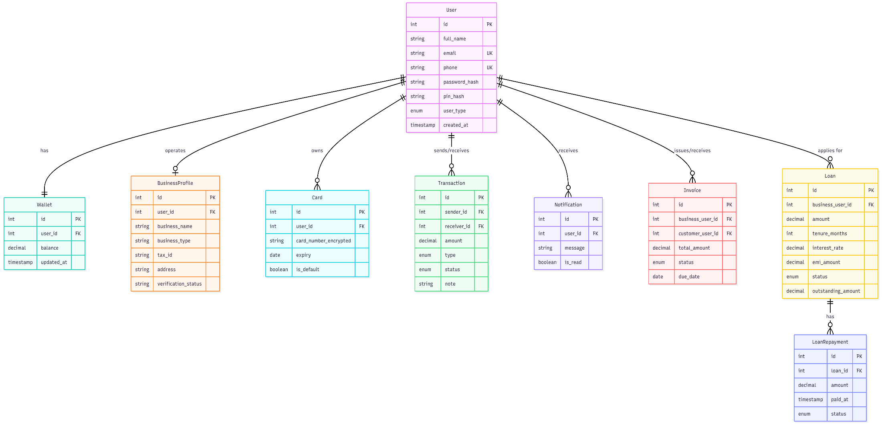
ER Diagram

Slide 8
02
System Features and Design

Slide 9
Authentication and Security
Security is a core focus, with bcrypt hashing for password storage ensuring one-way salted encryption. A separate transaction PIN restricts access to sensitive operations. Card details are secured with AES-256 encryption, storing only encrypted data in the database. These robust measures safeguard user data and transactional integrity.

Slide 10

Wallet and Transaction System
Each user has a single wallet which processes all monetary flows. Wallet balances are updated using database locking to prevent inconsistencies. Every transaction is logged permanently, creating an immutable audit trail. This guarantees no balance modification occurs without a corresponding, traceable transaction record.

Slide 11
Business Finance Features (Invoice & Loans)
Business users benefit from an invoice workflow enabling creation, notification, acceptance, and payment, tracked by statuses like SENT, ACCEPTED, and PAID. The loan management system supports applications, approvals, wallet crediting, and EMI deductions with balance checks. These features streamline business finance operations securely and efficiently.

Slide 12

Conclusions
RevPay delivers a secure, modular financial platform supporting both personal and business needs. It ensures strong security, clear role separation, and comprehensive features including invoicing and loans. The design principles promote scalability and maintainability, with future plans to expand via REST APIs and advanced user interfaces to enhance accessibility and analytics capabilities.

Slide 13
Thanks!
DO YOU HAVE ANY QUESTIONS?

